Slide 1

v4

Slide 2


Welcome to
MLH Localhost: Python I
Wifi Network:
[Network]
Wifi Password:
[Password]
Event Hashtag:
#MLHLocalhost
Twitter Handle:
@MLHacks
Notes:
What to Edit:
Update this slide to include the wifi information.
What to Say:
Explain how to connect to the wifi.
Encourage participants to Post Photos on Facebook, Twitter or Intagram using #MLHLocalhost
What to Do:
Check that everyone is connected by asking the group to give you a signal if they are connected.

Slide 3
What will you learn today?
1
What Python is and what you can do with it
2
Basic Python syntax and structures
3
How to create and run Python programs
Notes:
What to Say:
Explain to participants what they will learn today
Learning is a core part of being a hacker and today they are going to learn something new
What to Do:
Get participants excited about the experience.

Slide 4
On your phone or in the browser, go to the URL below to answer 3 short check-in questions:
http://mlhlocal.host/checkin
Notes:
What to Say:
Tell attendees we are going to check them in for the event
Once attendees checkin, they will receive an email with the items listed on the slide
Attendees must checkin to get credit for attending this event
What to Do:
Confirm that everyone has checked in by asking participants to give you a signal when they receive the email.

Slide 5

Our Mission is to Empower Hackers.
65,000+
HACKERS
12,000+
PROJECTS CREATED
400+
CITIES
We hope you learn something awesome today!
Find more resources: http://mlh.io/
Notes:
What to Say:
Major League Hacking (MLH) events are meant to bring hackers together so they can learn, build, and share.
Give participants a brief overview of Major League Hacking (MLH).
Tell participants they can learn more at http://mlh.io/
Example Talking Points:
TODO
Through Localhost MLH is rethinking technology education to reflect how hackers actually learn and how fast the industry moves.
Here’s some quick facts about MLH:
Each year, MLH supports over 65,000 hackers around the world at events they facilitate
Those students create more than 12,000 amazing projects together
MLH is a global organization that empowers hackers in more than 400 cities and growing every day

Slide 6
Why does this matter?
1
Coding is the new literacy.
There are millions of careers where you can earn a lot of money and make a difference that use Python.
2
3
Once you learn one programing language, you can learn any!
Notes:
What to Say:
Explain to participants what they will learn today
Learning is a core part of being a hacker and today they are going to learn something new
What to Do:
Get participants excited about the experience.

Slide 7
How many people here have coded before?
What languages have you used? What have you built?
Notes:
What to Say:
Read the slide.

Slide 8

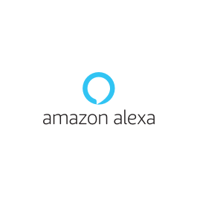
Introduction
This workshop is the first in a series of three workshops that will teach some Python basics that you can use for many purposes, such as artificial intelligence. Artificial intelligence might sound like something from the future, but it's actually all around you:
Siri and Alexa use a type of AI called Natural Language Processing to listen to spoken words and respond to them.

Slide 9

Introduction
This workshop is the first in a series of three workshops that will teach some Python basics that you can use for many purposes, such as artificial intelligence. Artificial intelligence might sound like something from the future, but it's actually all around you:
Netflix uses artificial intelligence to predict what you'll like to watch. That's where the "77% match" ratings come from.

Slide 10

Introduction
This workshop is the first in a series of three workshops that will teach some Python basics that you can use for many purposes, such as artificial intelligence. Artificial intelligence might sound like something from the future, but it's actually all around you:
Capital One's new eno tool helps you determine if someone has stolen your card number and to manage your finances using machine learning and natural language processing.

Slide 11

Introduction
There are a lot of things you'll need to learn to be able to write your own artificial intelligence applications. In this series, we're going to start with the basics!
Today, you'll cover the basics of writing code in Python. In later workshops, you'll use a natural language processing library to create a bot of your favorite Twitter celebrity!

Slide 12
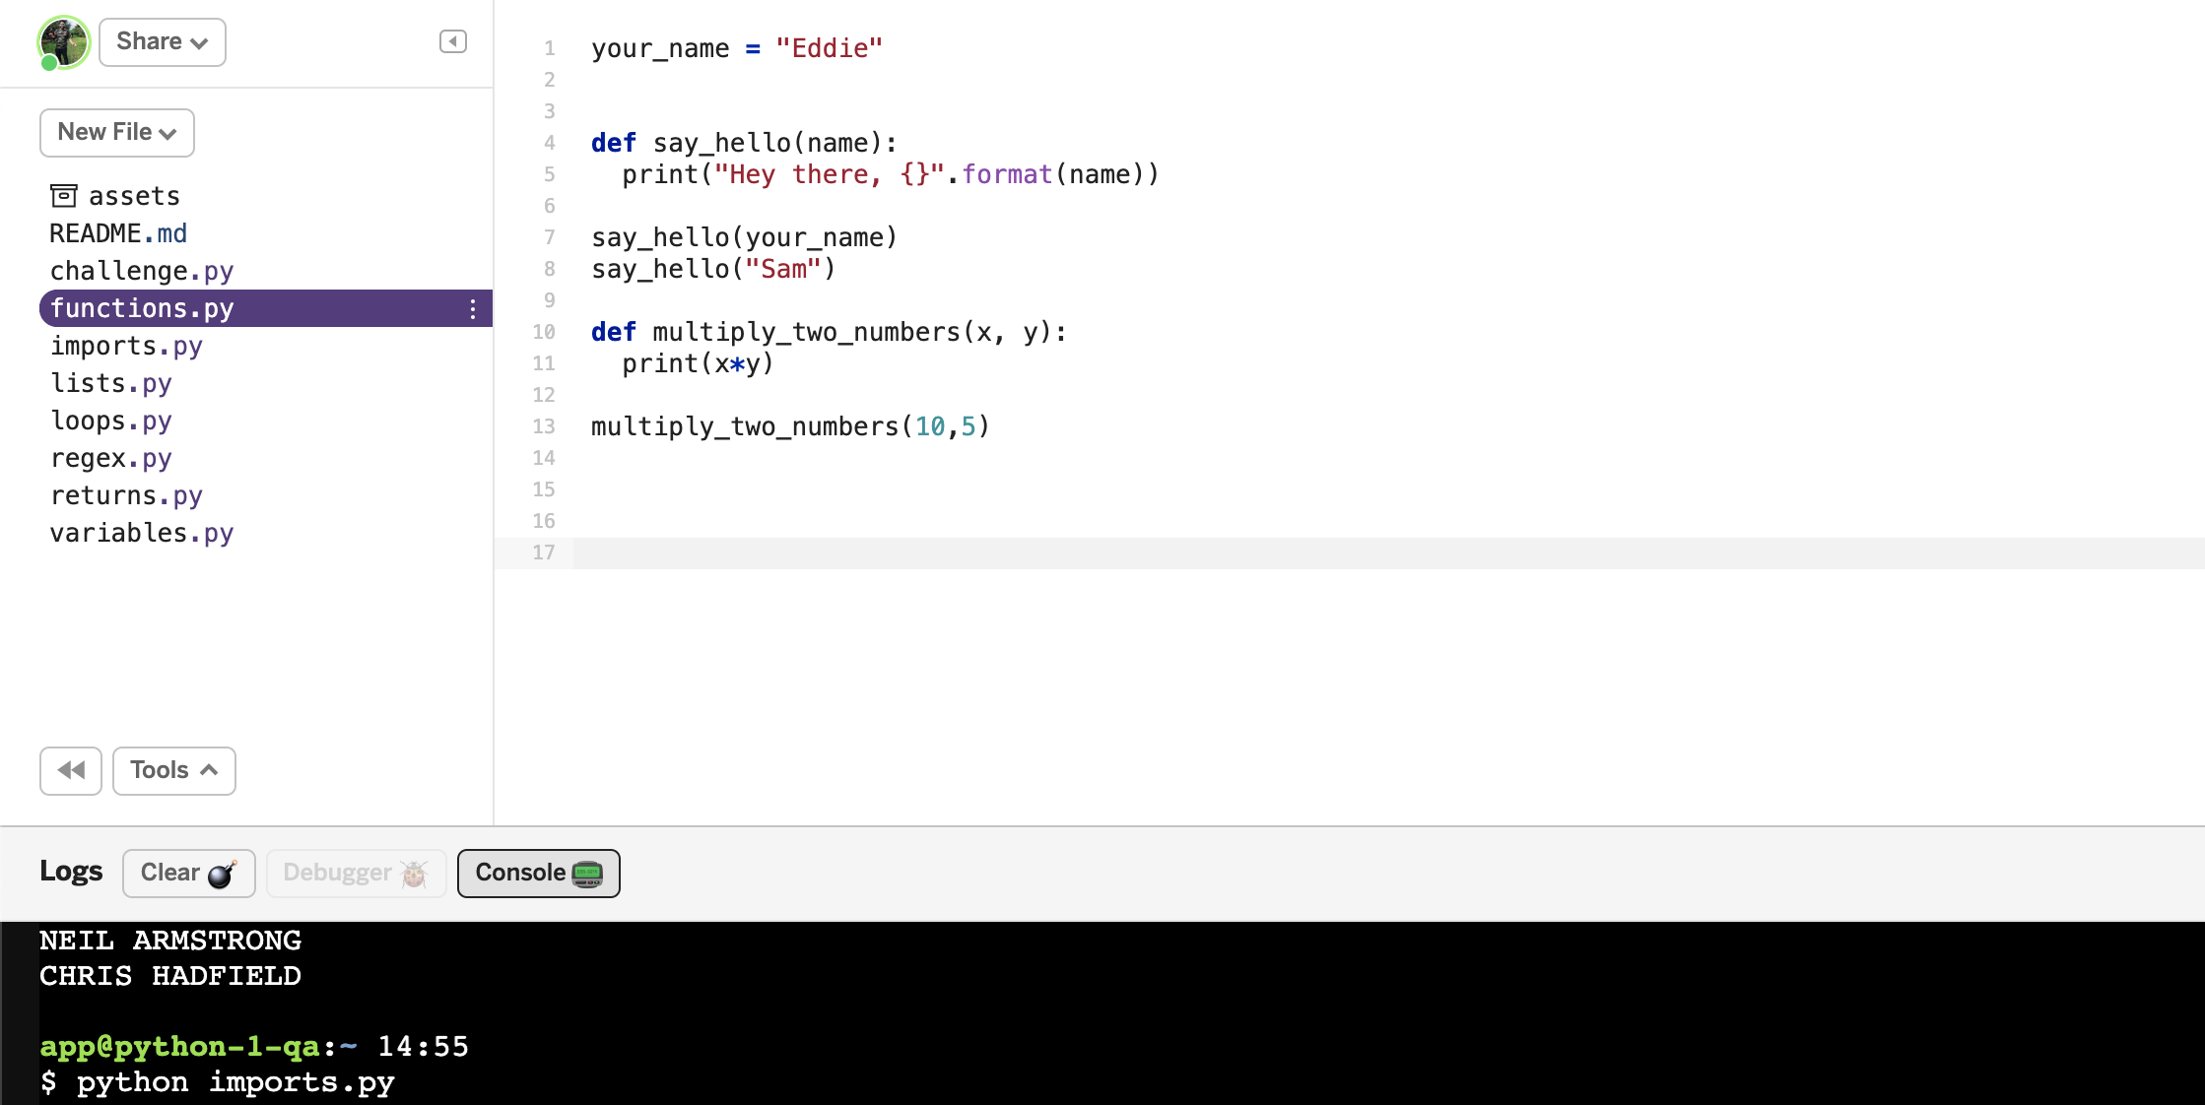
What are you going to build today?
Today you’re going to learn the fundamentals of Python by writing various pythons scripts and running them in the console.
Key Terms
Console: A application that runs python files.

Slide 13
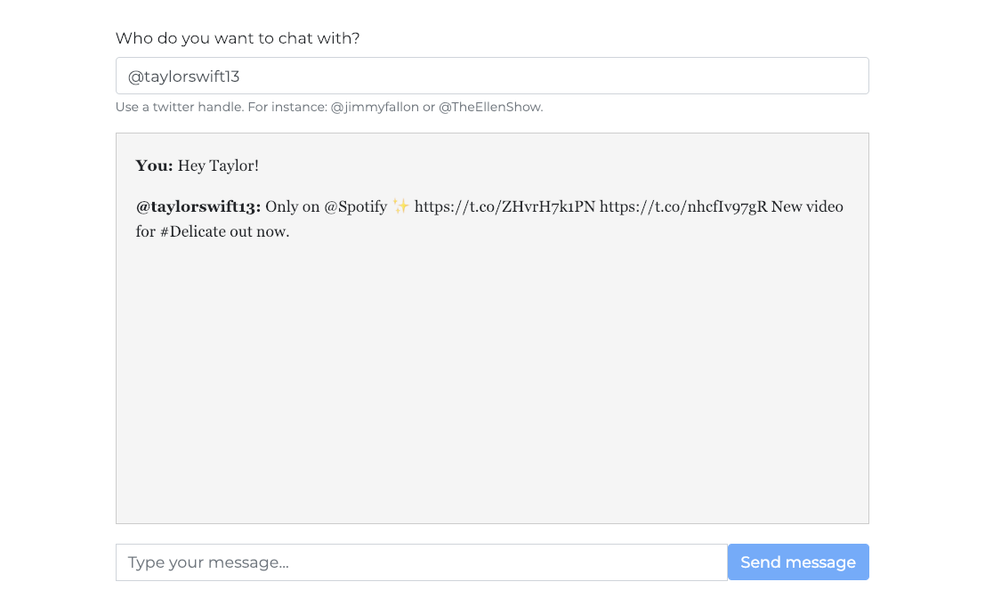
What you will be able to build
You will be able to build the below project in later workshop series that uses artificial intelligence to scrape Tweets off Twitter.
http://mlhlocal.host/glitch-bot
Key Terms
Web scraping: Collecting data from a website

Slide 14
How does this work?
When a user enters the Twitter handle of another user, that information is put into your script.
The script pulls some of the tweets from the Twitter user using a process called "web scraping."
Once your script has this information, it runs some functions on it. Functions are code you can use over and over again.
Then, a function removes the information we don't want and prints the information we do.
Key Term
functions: A few lines of code, grouped together, that your program can use as many times as it wants.

Slide 15



How are you going to do it?
These are the steps you'll need to take:
Sign up for Glitch.
Copy the Code.
Learn the basics of Python.
Write a few Python functions.
Scrape Twitter using Python.
Format your information.
Review and next steps!

Slide 16
Let's get started!
Notes:
What to Say:
Read the slide.

Slide 18
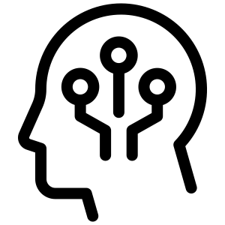
What is Python?
Python is an interpreted, high-level coding language.
Python was invented by Guido van Rossum in 1991.
Python can be used to make web pages, apps, and scripts.
One of the most common uses for Python is artificial intelligence and machine learning!
You're learning some Python basics today as the building blocks to go on and learn more about machine learning/AI later in your academic career.

Slide 19
Python Basics
You'll learn the following basic Python tools today:
Variables - variables in programming are a lot like variables in math! They store information for us.
Loops - loops are a structure your program can use to perform the same task multiple times (rather than coding it out by hand every time).
Functions - a structure you can use in your program to reuse bits of code throughout the program
Running your program - you'll learn how to run your program by entering commands into the Glitch console
Key Term
console: Part of the Glitch coding environment where you enter commands and see output

Slide 20
The best way to learn to code is to CODE, not to read about it, so let's set up Glitch!
Notes:
What to Say:
Read the slide.

Slide 22
Note: You're going to need to check your email to verify sign-up. Please sign into your email now!
Notes:
What to Say:
Read the slide.

Slide 23
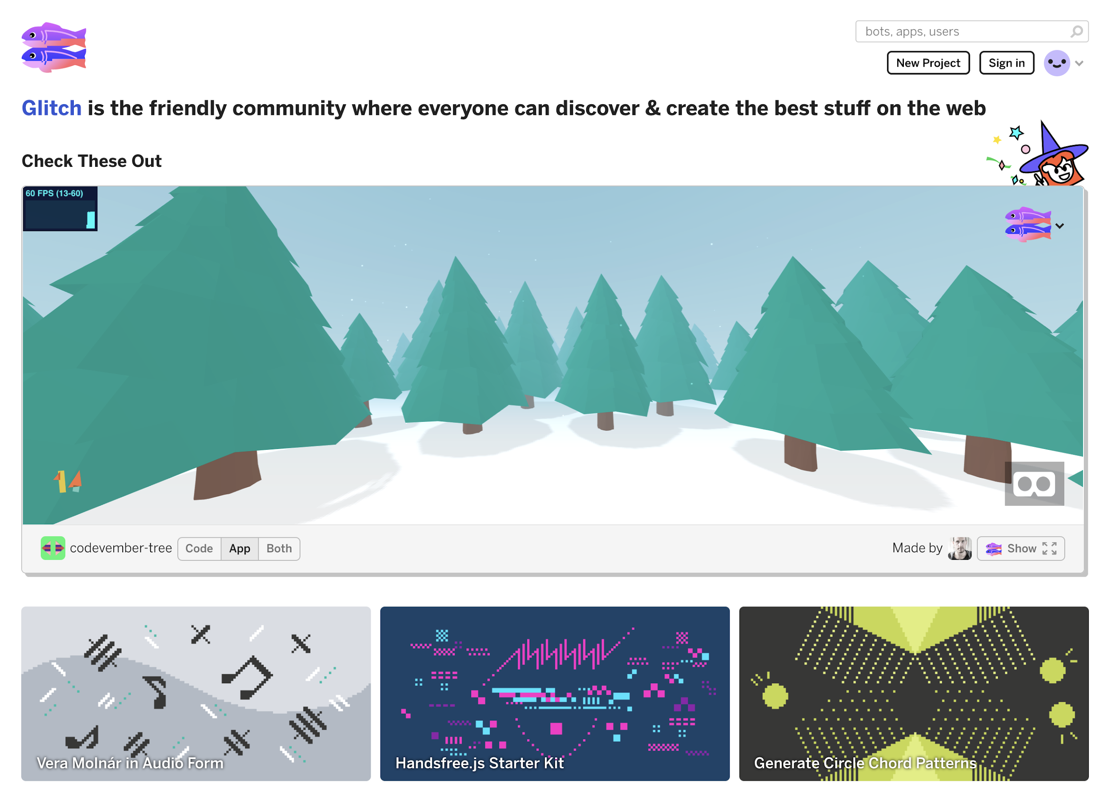
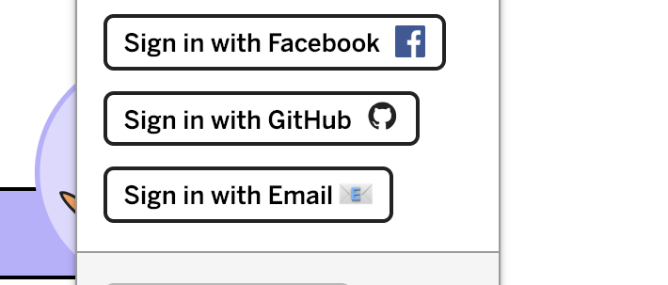
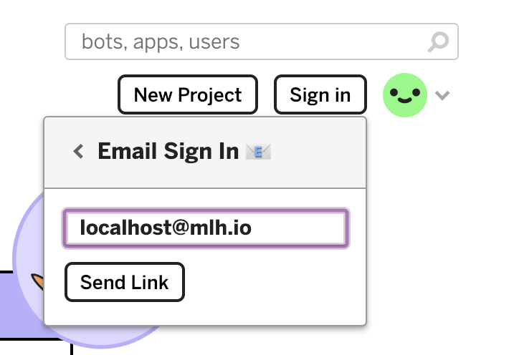
Let's set up Glitch!
http://mlhlocal.host/glitch
Navigate to the URL above.
Click Sign in.
Click Sign in with Email.
Enter your email address and click Send Link.

Slide 24
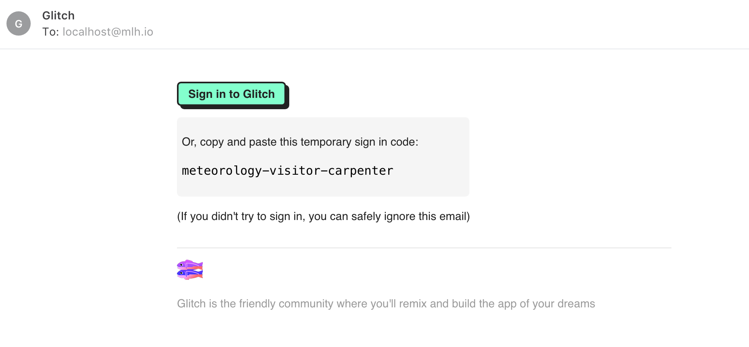
Let's set up Glitch!
Go to your email and look for the email below:
Click Sign in to Glitch.

Slide 25
Great! You're signed up. Now let's get the code!
Notes:
What to Say:
Read the slide.

Slide 26
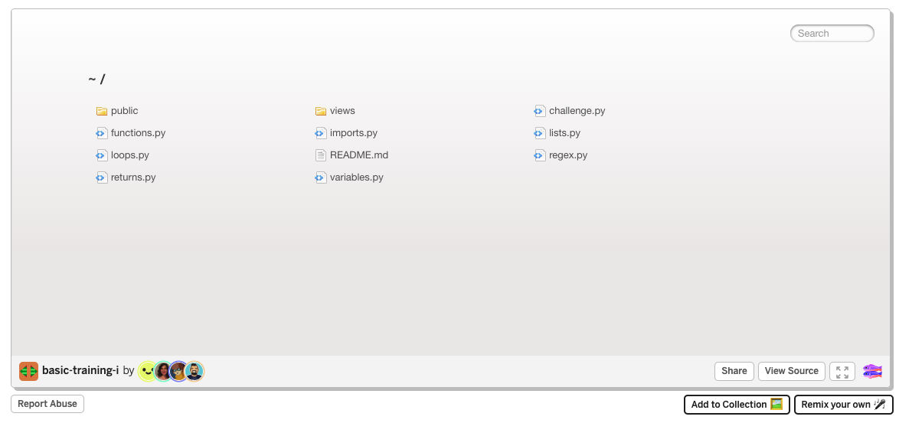

Get the code!
http://mlhlocal.host/glitch-python-i
Go to the URL above.
Click Remix your own, to make your own version

Slide 27
You now have your own version of the project. This is the code you’ll need to complete the workshop.
Let's dive in.
Notes:
What to Say:
Read the slide.

Slide 29
Programming 101: Variables
Notes:
What to Say:
Read the slide.

Slide 30
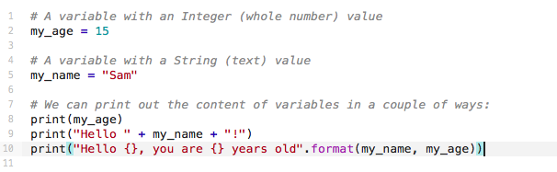
Write Code: variables.py
A variable stores some data - like numbers or text.
We can create variables, give them values, and modify those values later.
Click on variables.py in Glitch, and type
in the following code:
Notes:
Common problems to debug:
> Forgetting the second )) on Line 9 (every opening bracket needs a closing one!)
> Mixing up () and {} brackets.

Slide 31
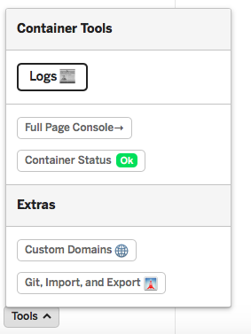
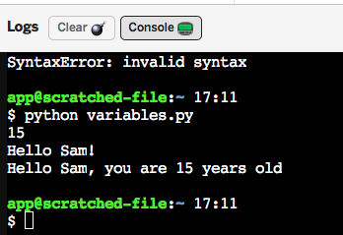
Running the Script
Click Tools at the bottom of the page, then Logs.
Click Console and type in python variables.py .
Then hit enter!

Slide 32
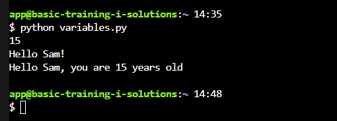
Running the Script
The console will display anything inside the print() statements.
Each print statement is on a new line.

Slide 33
Write Code: Modifying Variables
Once we’ve created some variables, we can modify them - this means changing their value. Try adding the code below to variables.py and running it again:
11
12
13
14
15
a = 5
b = 10
c = a + b
print(“a plus b = {}”.format(c))
Experiment with different maths operators:
Subtraction: -
Division: /
Multiplication: *

Slide 34
Let's talk about functions!
Notes:
What to Say:
Read the slide.

Slide 35
Functions
A function allows us to re-use a block of code over and over.
You’ve already used a few without realising! print() and format() are Python functions.
Functions have a few features:
Name: Functions have a name, and when we type the name, we call (use) the function.
Parameters: We can give the function a variable (or multiple!) to use. When we use the print() function, everything inside the brackets () is used by the function.

Slide 36
Write Code: functions.py
Open the file functions.py and let’s write some more code:
1
2
3
4
5
6
7
8
your_name = “Jamie”
# Lines 4-5 are a function called ‘say_hello’
def say_hello(name):
print(“Hey there, {}”.format(name))
say_hello(your_name)
say_hello(“Sam”)
Try running it by typing python functions.py into the console.
Let’s explain what’s happening...
Notes:
The main issue you may find with copying this code is the indent on line 5. It must be a tab (or two spaces) otherwise the compiler will complain loudly!
After typing a colon (:) to start the function, and hitting enter, the code should automatically indent itself the correct amount.
You may add that lines that start with # are comments and are ignored when the program is run. They’re optional to type.
We exit the function by setting the indentation back to the original (like on Line 7). This is a bit different to say, JavaScript or Java, where we would start and finish a function with { curly brackets }.

Slide 37
Code Review: functions.py
1
2
3
4
5
6
7
8
your_name = “Jamie”
# Lines 4-5 are a function called ‘say_hello’
def say_hello(name):
print(“Hey there, {}”.format(name))
say_hello(your_name)
say_hello(“Sam”)
Lines 4-5: This is our function. We use the def (define) keyword to start a function. We give it a name (say_hello) and a parameter (name).
Notice that line 5 is indented under line 4. Anything that comes later that is not indented is not part of the same function (line 6).

Slide 38
Code Review: functions.py
1
2
3
4
5
6
7
8
your_name = “Jamie”
# Lines 4-5 are a function called ‘say_hello’
def say_hello(name):
print(“Hey there, {}”.format(name))
say_hello(your_name)
say_hello(“Sam”)
Lines 7-8: We call the function by typing its name and giving a value to the name parameter. Whichever parameter we give the function is used! This is called passing the variable into the function.
Notes:
A common question from participants is ‘why is the variable called ‘your_name’ on line 7, but ‘name’ in lines 4-5?
Answer: In the function (4-5), the variable ‘name’ is a reference. It means that when we call the funcion (on lines 7 and 8), we substitute whatever is in the brackets - ‘’your_name’, or ‘sam’ - into the function.
You can explain this more visually by creating some more variables and calling the function multiple times with them, for example:
X = “Mary”
this_is_a_really_long_variable_name = “Stephen”
say_hello(X)
say_hello(this_is_a_really_long_variable_name)

Slide 39
Challenge
You can pass multiple variables into a function!
To do this, separate parameters with a comma when you create the function, like this:
1
2
3
4
5
def my_function(parameter_1, parameter_2):
# do things with parameter_1 and parameter_2
Write a function that takes 2 parameters, multiplies them together, and prints the result.

Slide 40
Challenge
Write a function that takes 2 parameters, multiplies them together, and prints the result.
1
2
3
4
5
def multiply_numbers(num_one, num_two):
# How do we multiply num_one and num_two
# together and print the result?
Here’s some code to get you started.

Slide 41
Don't peek! The solution is on the next slide.
Notes:
What to Say:
Read the slide.

Slide 42
Challenge: Solution
1
2
3
4
5
def multiply_two_numbers(x, y):
print(x*y)
multiply_two_numbers(10,5)

Slide 43
Returning Values from Functions
So far, our function uses the parameters within the function.
What if we wanted to use the result somewhere else?
1
2
3
4
5
def multiply_two_numbers(x, y):
print(x*y)
multiply_two_numbers(10,5)
We can do this by Returning values from functions.
Let’s see what that looks like!

Slide 44
Write Code: returns.py
Open up returns.py and add the following:
1
2
3
4
5
6
def create_full_name(first_name, last_name):
full_name = first_name.upper() + “ “ + last_name.upper()
return full_name
create_full_name(“Neil”, “Armstrong”)
The upper() function changes a string to all upper case (CAPITAL LETTERS!).
Run the program. What happens?

Slide 45
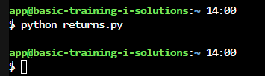
returns.py
Nothing happened!
Maybe you expected that - we didn’t tell the function to print anything.
How can we use the Return value of our function to make it useful?

Slide 46
Write Code: returns.py
Go back to the code and add a piece on Line 5-6:
1
2
3
4
5
6
def create_full_name(first_name, last_name):
full_name = first_name.upper() + “ “ + last_name.upper()
return full_name
result = create_full_name(“Neil”, “Armstrong”)
print(result)
Now, we have a variable called result, and we’ve set the value to be the output of our create_full_name() function! Nifty!
Run the program again. What happens now?

Slide 47
Cool, now you know a little bit about functions!
Let's talk about loops!
Notes:
What to Say:
Read the slide.

Slide 48
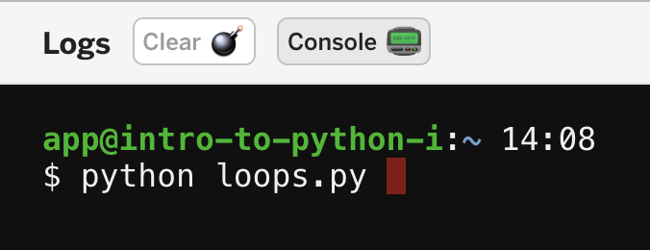
Code Review: loops.py
Click on loops.py.
What do you think this code does?
To test it, enter python loops.py in your console!
1
2
3
4
5
6
7
8
9
10
print(“Day 1”)
print(“Day 2”)
print(“Day 3”)
print(“Day 4”)
print(“Day 5”)
print(“Day 6”)
print(“Day 7”)
print(“Day 8”)
print(“Day 9”)
print(“Day 10”)

Slide 49
What just happened?
In the previous file, we had to write 10 separate lines of code to get the program to print Day 1, Day 2, etc. However, the only thing different on each line was the number. Imagine if we had to print 100 days! This would be awful. Is there a better way?

Slide 50
What just happened?
LOOPS!
In the previous file, we had to write 10 separate lines of code to get the program to print Day 1, Day 2, etc. However, the only thing different on each line was the number. Imagine if we had to print 100 days! This would be awful. Is there a better way?

Slide 51
What just happened?
LOOPS!
In the previous file, we had to write 10 separate lines of code to get the program to print Day 1, Day 2, etc. However, the only thing different on each line was the number. Imagine if we had to print 100 days! This would be awful. Is there a better way?
Sometimes in programming you want to do the same task over and over again. A loop is an easy way to tell your program to do that.
Key Term
loop: a way to repeat the same task many times in a program, without writing it out each time

Slide 52
Code Review: loops.py
1
2
3
for num in range (10):
print(“Day {}”.format(num))
Delete all the code in loops.py
Add this code to loops.py and run the file.
Before you view the output in the console, what do you think it will look like?

Slide 53
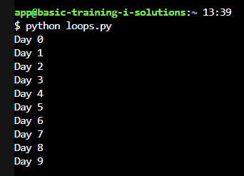
What happened?
Our script printed out the ‘Day’ line 10 times! Not bad for two lines of code.
However… Notice anything wrong?
Notes:
Open question - someone should notice that it has started at 0, not 1.

Slide 54
What went wrong?
1
2
3
for num in range (10):
print(“Day {}”.format(num))
loops.py only printed up to Day 9. Why did this happen?
When using a range loop in Python, it prints up to but not including the number in parentheses. This is called an "off by one error," because our program did what we wanted it to except for 1 number.

Slide 55
Challenge
1
2
3
for num in range (10):
print(“Day {}”.format(num))
Get loops.py to print through Day 10.

Slide 56
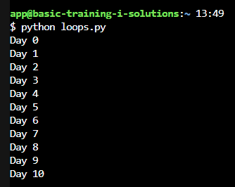
Solution
1
2
3
for num in range (11):
print(“Day {}”.format(num))
Change (10) to (11).
Run your program again!

Slide 57
We’re making great progress!
Let’s move on to Lists.
Notes:
What to Say:
Read the slide.

Slide 58

Lists
Variables store a single value.
What if we wanted to have a list of related variables? Like a list of names, or phone numbers?
This is where Lists come in handy. In other programming languages, you might find them called Arrays.

Slide 59
lists.py
There’s a few ways we can create Lists in Python. Open up lists.py and type in this code:
1
2
3
4
5
6
# Creates an empty list
names = []
# Creates a list with values
planets = [“Mercury”, “Venus”, “Earth”, “Mars”]
Try adding some code to print names and planets. What does the output look like?

Slide 60
Adding Values to Lists
Once we’ve created a List, we can continue adding values to it by using the append() function, like this:
4
5
6
7
8
9
10
# Creates a list with values
planets = [“Mercury”, “Venus”, “Earth”, “Mars”]
planets.append(“Jupiter”)
planets.append(“Saturn”)
print(planets)

Slide 61
Retrieving Values from Lists
If we print() our list, we get all of the contents. What if we only want a single value from the list?
Thankfully for us, Python Lists maintain an index of their contents. This means we can access a value by its index number.
4
5
6
7
8
9
10
# Creates a list with values
planets = [“Mercury”, “Venus”, “Earth”, “Mars”]
planets.append(“Jupiter”)
planets.append(“Saturn”)
print(planets[1])
What will be the console output of planets[1]? Guess before you run the code!

Slide 62
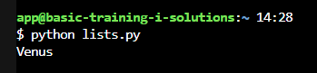
Retrieving Values from Lists
You might have guessed Mercury - it’s the first value in the list, right?
But the console prints Venus! Why is that?
Lists start at index Zero! To a computer, 0 is a perfectly useable number.
Try printing out planets[0] instead.

Slide 63
Looping through Lists
We covered Loops, and Lists, so how about… Looping over lists!
Add this loop to lists.py.
11
12
13
14
for planet in planets:
print(planet)
Run lists.py and check the output.
This is called iterating over a list.
Notes:
Notes: People tend to get confused as to where ‘planet’ came from. Some extra explanation: We can loop over each item (X) in a list by using the expression ‘for X in List’. We can substitute any word for the X (the item), but it makes sense to call it something that references what it is.
For example:
for phone_number in address_book
for pokemon in pokedex
We could say ‘for X in planets’ and it would work; but it doesn’t really tell us what X is and can get confusing, particularly if we have lots of lines of code inside the For loop. Clarity is key!

Slide 64
We’re flying through this!
Let’s talk about Importing.
Notes:
What to Say:
Read the slide.

Slide 65
Imports
As you’ve seen so far, Python has a lot of in-built functions, like print(), upper(), and range().
Sometimes we want to extend the functionality of Python by using functions that someone else has written for a specific purpose - these are called Modules.
We can even import other Python files we’ve written ourselves, so we can use their functions!

Slide 66
Imports
Take a look at the returns.py file.
By creating a Python file with some functions in it, we’ve created a Module called Returns.
1
2
3
4
5
6
def create_full_name(first_name, last_name):
full_name = first_name.upper() + “ “ + last_name.upper()
return full_name
result = create_full_name(“Neil”, “Armstrong”)
print(result)
What if we wanted to use the create_full_name function in another Python file? Let’s do that!

Slide 67
Importing Our Functions
Open up imports.py and add this:
1
2
3
import returns
print(returns.create_full_name(“Chris”, “Hadfield”))
We use the import keyword to import modules we want to use.
Here, we’ve imported our other Python script, returns.py!
Now we can use the function we wrote inside returns.py.
All we have to do is tell Python where the function is coming from, by typing returns.create_full_name instead of just the function name.
Notes:
Folks might ask whether they have to remove lines 5 and 6 from the returns.py file. We don’t! When we import a module, all that Python cares about are the functions inside the file (anything that starts with ‘def’).

Slide 68
Importing External Modules
A useful module to have is the Random module. It helps us to generate random numbers.
1
2
3
import random
print(random.randint(0,100))
The Random module has a function called randint() (Random Integer).
We can give it two parameters: a start point and an end point.
This will generate a random whole number between these two values.

Slide 69
What a whirlwind!
We’ve learned a lot today.
How about we put this all together?
Notes:
What to Say:
Read the slide.

Slide 70

Challenge
So far, we’ve learned about Variables, Loops, Lists, Functions, Importing, and more!
Let’s write a script that combines these ideas!
Open up challenge.py and give it a try!
Notes:
Depending on time constraints, you may want to vary how much time you give folks to try this. You could suggest they do it in pairs/groups.

Slide 71
Challenge Time!
Find yourself a partner - someone in the room that you don’t know!
Notes:
Get folks to pair up (or in threes). Encourage them to say hello to someone they don’t know and do an introduction. Give them 5 minutes to complete the challenge.
The details of the challenge are in challenge.py. If you want to verbalise it:
I want to see 10 lists of random numbers.
The first list will have 0 items, the second will have 1 item, the third will have 2 items, etc.
Each list item will be a random Integer between 0 and 100.
If we print all of the lists, it should look something like this:
[]
[65]
[57, 71]
[51, 30, 84]
[39, 10, 38, 73]
[33, 25, 48, 10, 73]
[15, 13, 20, 72, 76, 6]
[73, 75, 85, 83, 66, 98, 32]
[64, 8, 79, 13, 14, 26, 46, 56]
[48, 59, 19, 90, 25, 56, 78, 84, 62]

Slide 72
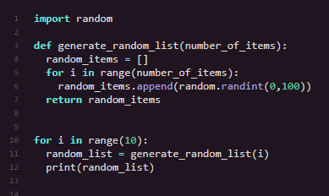
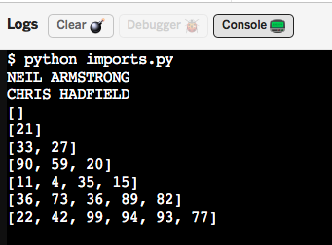
Challenge Solution
It’s important to remember that coding problems have lots of different solutions! If yours doesn’t look like this, don’t worry.

Slide 74
Let's Recap
Where to go from here...
Python is a programming language you can use for data analysis and artificial intelligence
1
2
Python tools you can use include functions, lists and loops.
3
We can extend Python functionality even further by importing modules.

Slide 75
What did you learn today?
We created a fun quiz to test your knowledge and see what you learned from this workshop.
http://mlhlocal.host/quiz
Notes:
What to Say:
Read the slide.
What to Do:
Get participants excited about taking the quiz. Encourage them all to take it, and pass out stickers to participants who earn 100s. Also encourage participants to take the survey - let them know that Localhost takes their feedback very seriously and we use their feedback to make the workshop better for future participants.

Slide 77
Next Steps
Where to go from here...
Check your email for lots of resources to keep learning!
1
2
Edit the part of the file that prints out the timeline however you want.
3
Take the second workshop!

Slide 78
v.0.0.1

